Slide 1
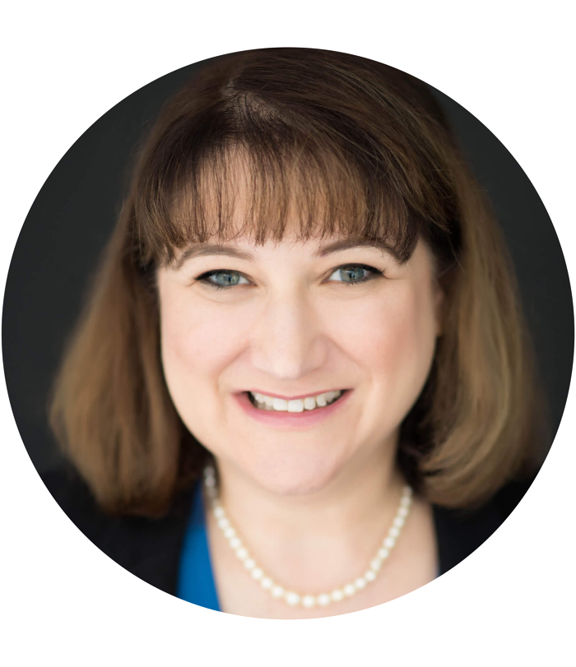
Bid & Protest What to do before you run to your lawyer?
Presented by:
Karen Long
Streamline Government
Contracts, LLC
www.streamlinegovcon.com

Slide 2
The Asian American Chamber of Commerce (AACC) is dedicated to improving the economic development for Asian Pacific American owned businesses in VA/DC/MD.
AACC facilitates the growth and development of member businesses through AACC sponsored events such as business networking programs, Business Expo, Business Development Workshops, Seminars and other special events.
AACC provides a platform for our members to network and market their products and services. For companies seeking to diversify their supplier base, AACC members are a great place to start.
ABOUT the
ASIAN-AMERICAN CHAMBER OF COMMERCE
Contact AACC for Sponsorship Opportunities

Slide 3
MEMBERSHIP BENEFITS
Numerous Networking Events
High visibility in the Asian business community
Representation of minority & women-owned business community
Reciprocal benefits with member partners and other organization
Professional, mentorship, and volunteer opportunities and resources
Up-to-date information on public policy, news, and events

Slide 4
Disclaimer
This webinar is for informational purposes only. None of the content is, nor shall be deemed to constitute legal opinions or legal advice.
Copyrights apply. Please do not copy this material without written consent from the Asian-American Chamber of Commerce.

Slide 5
Protests: What You Should Do Before Running to Your Lawyer
21 February 2020
Streamline Government Contracts, LLC
Reduce Risks. Increase Profits.

Slide 6
ABOUT:
KAREN LONG, M.S., MBA, CFCM
President and Founder of Streamline Government Contracts, LLC
15+ years of experience with small and mid-size companies
Klong@Streamlinegovcon.com
240-644-5314
ABOUT:
KAREN LONG, M.S., MBA, CFCM
President and Founder of Streamline Government Contracts, LLC
15+ years of experience with small and mid-size companies
Klong@Streamlinegovcon.com
240-644-5314

Slide 7
AGENDA
Introduction
Pre-Award vs Post-Award Protests
Pre- Award Timelines
Responsive Proposal?
Debriefings
Post-Award Timeline Variables
Questions

Slide 8
Pre-Award vs Post-Award Protests
Pre-Award Protest Examples:
Overly Restrictive Requirements
Invalid use of Sole Source
Ambiguous or Faulty Evaluation Criteria
Incomplete Statement of Work (SOW)

Slide 9
Pre-Award vs Post-Award Protests (cont.)
Post-Award Protest Examples:
Unfair or unreasonable Evaluation Criteria
Not Evaluating as Advertised
Unequal Treatment
Awardee Misrepresented Disadvantaged Status

Slide 10
Pre-Award Protest Timeline
Solicitation Challenges:
Prior to the time of submission
Challenges to Removal from Competition (e.g. Competitive Range)
10 days of when debriefing or knowledge of grounds for protest
Additional Resources: Read “Separating Fact from Fiction – Bid Protests: How They Work, Why to File, and What to Expect” by Victoria Woodlock, ProposalHelper and Isaias “Cy” Alba, PilieroMazza | 15 Feb 2020

Slide 11
Did your company Submit a Responsive Proposal?
It includes ensuring:
the proposal was submitted on time;
the correct size font was used;
the page count was not exceeded for each section;
the cover letter included all items requested; and
the correct validity period was used.

Slide 12
Did your company Submit a Responsive Proposal? (cont.)
Include the Requirements for each section (e.g. Management Approach, Understanding the Problem, etc.).
Use the Resume format provided.
Complete and accurate Past Performance Information.

Slide 13
An example of a Compliance Matrix to Ensure your Company is Answering the Mail
This is just one example. Companies use different variations. The important part is that you create an accurate and compliant ‘Compliance Matrix’ and consistently use it.

Slide 14
Is your company an Interested Party?
An interested party is an actual or prospective offeror whose direct economic interest would be affected by the award of the contract or failure to avoid the contract.

Slide 15
What You are Entitled to at a Debriefing
A debriefing within 5 days after receipt of the request, if reasonably practical.
A debriefing in writing, orally, or by any other method acceptable to the Contracting Officer.
Significant weaknesses in the Offeror’s proposal as determined by the Government.

Slide 16
What You are Entitled to at a Debriefing: (cont.)
Overall technical rating and price of the Successful Offeror.
Overall ranking of all Offerors.
Summary of rationale for award.
Make and model of commercial items, if any, to be delivered by Awardee.

Slide 17
What You are Not Entitled to at a Debriefing
Point by point comparisons to other Offeror’s proposals.
Trade secrets or other confidential manufacturing processes or techniques.
Financial proprietary information including indirect rates from other Offerors.
Names of individuals providing reference information on Offeror’s past performance.

Slide 18
Post-Award Protest Timeline Variables
Between 4-10 days depending on:
Type of solicitation (Negotiated Procurement (FAR Part 15), Commercial Items (FAR Part 12), Multiple Award Schedule (FAR Part 8) or Task Order/IDIQ (FAR Part 16)
Depends upon venue: Agency Level, GAO (Government Accountability Office, or U.S. Court of Federal Claims
Depends upon whether wanting a Performance Stay

Slide 19
Before You Run to Your Attorney
Do Your Homework.
Know the Timelines.
It can save you time and money!

Slide 20
THANK YOU FROM THE GOVCON COMMITTEE

Slide 21
Promote your company - interested in being a panelist on our webinar?
Contact: Bhatia@proposalhelper.com
Board Member at Asian-American Chamber of Commerce

