Slide 1

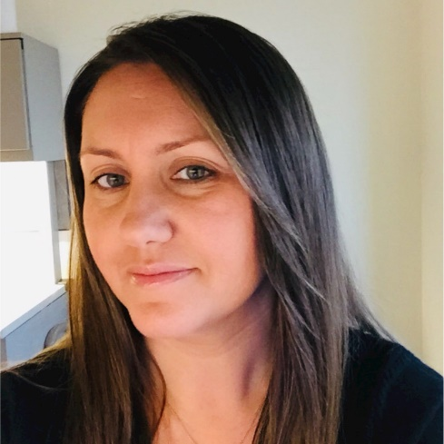
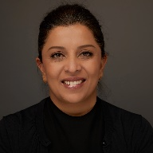
Maximizing Project Profit
Zaneta Handa
Chief of Staff
Manufacturing, A&D, Automotive and Life Sciences
Capgemini N.A
Practical advice on how to maximize profits on every project
Host and Moderator
Reena Bhatia

Slide 2

REENA BHATIA
Board Member of the Asian American Chamber of Commerce
CEO of ProposalHelper and BidExecs
Bhatia@proposalhelper.com | 703-589-7309
25 years experience in Business Development, Capture, and Proposals
Mentor and Advisory to GovCon Startups as Board Member
Global experience in public sector & commercial contracting in
the US, APAC, and Middle East

Slide 3

The Asian American Chamber of Commerce (AACC) is dedicated to improving the economic development for Asian Pacific American owned businesses in VA/DC/MD.
AACC facilitates the growth and development of member businesses through AACC sponsored events such as business networking programs, Business Expo, Business Development Workshops, Seminars and other special events.
AACC provides a platform for our members to network and market their products and services. For companies seeking to diversify their supplier base, AACC members are a great place to start.
ABOUT THE
ASIAN-AMERICAN CHAMBER OF COMMERCE
Contact AACC for Sponsorship Opportunities

Slide 4






MEMBERSHIP BENEFITS
Numerous Networking Events
High visibility in the Asian business community
Representation of minority & women-owned business community
Reciprocal benefits with member partners and other organization
Professional, mentorship, and volunteer opportunities and resources
Up-to-date information on public policy, news, and events

Slide 5

ZANETA HANDA
Chief of Staff, Manufacturing, A&D, Automotive and Life Sciences
20+ years of experience in commercial and Government consulting,
operations, Alliance management and partner marketing.
Joined Capgemini in January 2019 as Chief of Staff for the MALS Market
Unit, the largest business portfolio in Capgemini, valued at over $1B. She
oversees the growth strategy, relationships and operations for the market
unit.
She spent over 17 years with Booz Allen Hamilton, where she led the Civil
Market Business Operations team and managed a large-scale portfolio.

Slide 6
Disclaimer
This webinar is for informational purposes only. None of the content is, nor shall be deemed to constitute legal opinions or legal advice.
Copyrights apply. Please do not copy this material without written consent from the
Asian-American Chamber of Commerce.

Slide 7




HOW TO MAXIMIZE PROFITS ON EVERY PROJECT

Slide 8

Agenda
Benefits of Project Control
Why Job Profit and Why Now?
Job Profit Lifecycle
Job Profit Risk Mitigation

Slide 9
Benefits of Project Control
Hire the right experts with the right skill set
  Mitigate Risk
  Ensure FAR and DCAA compliance
Leverage their expertise, skills and budget tools
Generate more revenue by bidding Project Control as a billable function
Arrive at desired job profit targets
It’s how you build the right muscle to get to the playoffs

Slide 10
Why Job Profit and Why Now?
With current competitive market conditions and today’s COVID-19 impacted environment, it’s more important than ever to focus on profit margins
More competitive environment to win work
More competitive environment to acquire the right talent pool
Smaller margins
Everyone can and should contribute to Job profit objectives

Slide 11






Job Profit Project Lifecycle
Proposal
Development
Negotiations &
Awards
Positioning & Team
Addressable market & match
Qualifications
Nature of Work/Market Need
Creating demand
OCI implications
Relationships
Teaming & Subcontractors
Small Business
Strategy
Capture Review
Pricing & Cost
Solution Evaluation
Technical
Unbillable/Unallowable
Teaming Roles
Fee Rates
Labor caps & mix
Contract Vehicles
Payment schedule & method
Issue resolution
Project Kickoff
Project Execution
Closeout
Program Manager
Contract Analyst
SubK Analyst
Project Controller
Set expectations
Encourage open
communications
Graduate staff in LCATs
Maximize utilization
Manage risks
Manage scope creep
Manage Teams & Subs
Plan for fluctuations in labor
Maximize rate mix on upper
labor categories
Manage write-ups and write-
downs
Minimize adjustments
(leakage & post-mortem)
Pass audits

Slide 12
Think Thru Profit Decisions Early and Throughout Contract Lifecycle
Proposal Development
  Adopt pricing methodologies that stay within or above your company’s guidelines for profit/fee
  Bid a realistic mix of staff, anticipating actual LOE, FTEs and Subcontractors
  Run a profit analysis by individual and on total cost
  Bid project control hours as a billable cost whenever possible
Negotiations & Awards
  Make informed hiring decisions that fall within contract rate structure & budget
  On FFP contracts, ensure a defined set of deliverables and acceptance criteria
Project Kickoff
  Understand the terms and conditions of the awarded contract
  Hold a comprehensive kickoff meeting
  Gain understanding of how the contract was bid and how it must be executed to meet financial and profit expectations

Slide 13
Think Thru Profit Decisions Early and Throughout Contract Lifecycle (Contd.)
Project Execution
  Monitor and focus on direct reductions to profit
  Utilize and regularly monitor budget tools to avoid cost overruns, scope creep or lack of communication with client or subs
  Stay abreast of contract requirements
  Manage delivery against proposal plan and contract requirements
Regularly monitor labor mix
  Monitor employee mapping to LCATs (skill sets & qualifications)
  Look for opportunities to up slot/green staff in labor categories, as appropriate
  Monitor use of subs, ensure markup/profit meets objectives
  Ensure Option Year rate escalation is accurately applied
Notes:
Monitor and focus on direct reductions to profit
Unallowable/unbillable costs
Unbillable travel
Local travel expenses
Utilize and regularly monitor budget tools to avoid cost overruns, scope creep or lack of communication with client or subs
Stay abreast of contract requirements
Award fee evaluations
Ability to receive award or performance fees
Deliverable schedule
Manage delivery against proposal plan and contract requirements
Labor mix
Rate structure
Scope

Slide 14
Job Profit Risk Mitigation
Budget Reviews
  Meet regularly with PM and Project Controller to review project budget
  Perform regular cost to complete estimates to determine risk of over or under runs on contract funding
  Be aware of when incremental funding runs out and provide timely funding requests
  Reconcile your financial system and budget EVERY month
  Ensure timely and accurate timesheet and expense report entries
Project Management Reviews
  Meet regularly with PM, Project Leads and Project Controller to review status of each program
  Focus review on financial health of the project
Notes:
Ensure timely and accurate timesheet and expense report entries
Hours in suspense
Pending travel costs
SubK commitments, timesheets, expenses and invoices (within 15-20 days of work performed)
Focus review on financial health of the project, including:
Job Profit
Gross Revenue
Gross Revenue variance to Forecast
Value Added Revenue
Trends
Challenges

Slide 15
QUESTIONS?
Thank You
Contact ProposalHelper for contact information and additional support

Slide 16

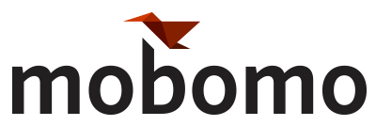
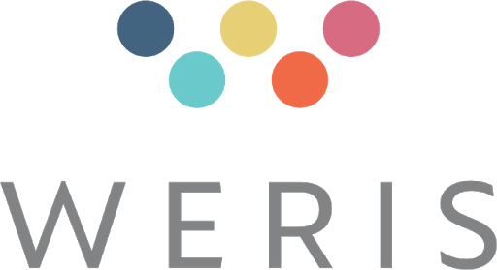

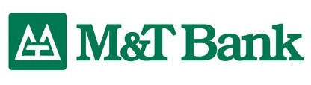

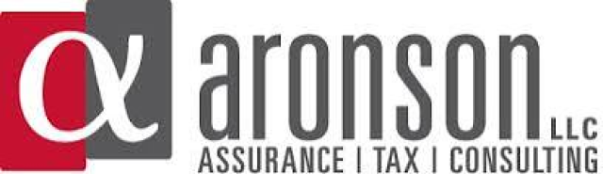

THANK YOU FROM THE GOVCON COMMITTEE

Slide 17
SPONSOR AACC GovCon Webinar Series

